Slide 1

LaunchCode Liftoff
Class 2
Kevin Beashore
12/9/21

Slide 2
Liftoff Project Timeline
User Stories & Trello
Git, Licensing, & Online Profiles
Class 1
Class 3
Class 2
Class 4
Wireframes & Project Outline (MVP)
Project Review 1
Notes:
Aggressive goals so we can provide as much direction as possible
Weekly progress
Something to review by Week 4
Break week
THIS IS THE YOU ARE HERE SLIDE!

Slide 3
Assignment - Project Outline
Note: One per individual (including teams – sharing is caring :D)
1-2 Paragraph “Elevator Pitch”
Identify 3-5 Features
List Technologies (Java, Spring, SQL, React, AWS, Etc.)
Identify Unknowns - What you need to learn
Based on individual
Setup Project Tracker (Trello board)
Add Initial User Stories
Set up GitHub
Enable GitHub Issues
TAs - Feedback on overview, identify learning resources
Notes:
Ok so normally you wouldn’t cover the assignment before you cover the material for it but *WHO CARES* I’m throwing a curve ball.
1-2 Paragraph “Elevator Pitch”
Explanation of the project – high level overview of project in non technical (plan English)
Identify 3-5 Features
COUGH These could be user stories COUGH
List Technologies (Java, Spring, SQL, React, AWS, Etc.)
Identify Unknowns - What you need to learn
Based on individual but the group could write out together and submit the some one if you like
Setup Project Tracker
Add Initial User Stories
Enable GitHub Issues
TAs - Feedback on overview, identify learning resources

Slide 4
Coding challenge
https://edabit.com/challenge/Q3n42rEWanZSTmsJm

Slide 5
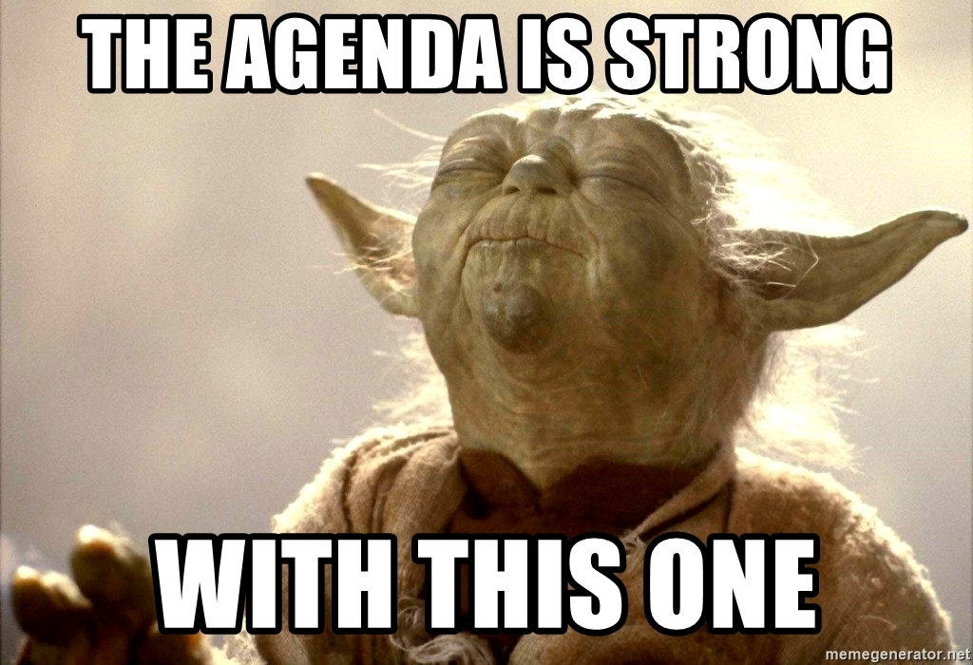
Agenda
Objectives
Lecture
Agile Continued – Features, MVP, Sprint
User Experience – Wireframing
Git Workflows
Activity (small groups)
Wireframing
Plan your MVP
Remember assignment
Q&A
Notes:
Party Parrot and Slack Accessibility
Will Do Some In-Class Examples, so grab a seat closer to see

Slide 6
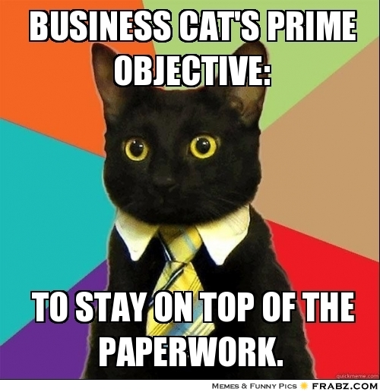
Objectives
Student should learn:
Why we use MVP
How Wireframes Help Plan Your Project
Build on our understand of an agile Sprint
Understanding basic git workflows

Slide 7
Lecture
Notes:
Any questions about tonight’s agenda, objectives, goals, or timeline? Assignments & Prep work?

Slide 8
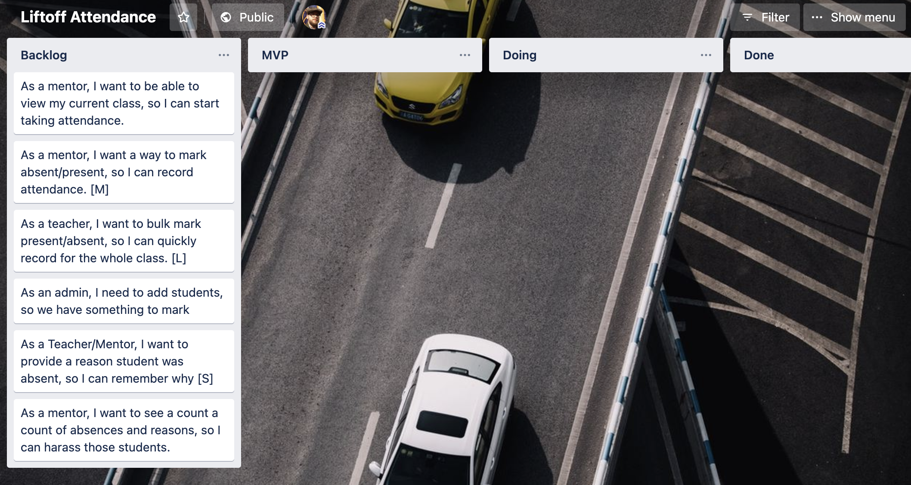
Demo - User Story Grooming
https://trello.com/b/keDvTLIl

Slide 9
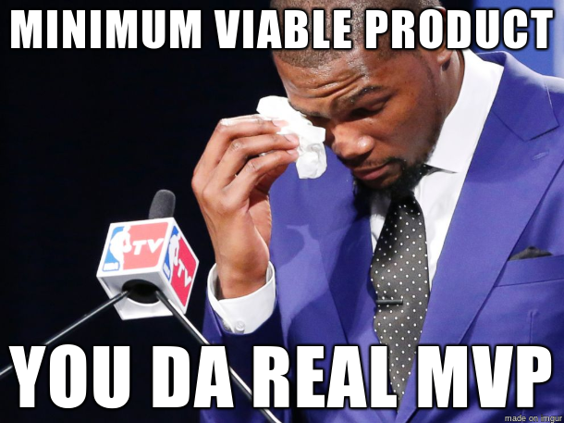
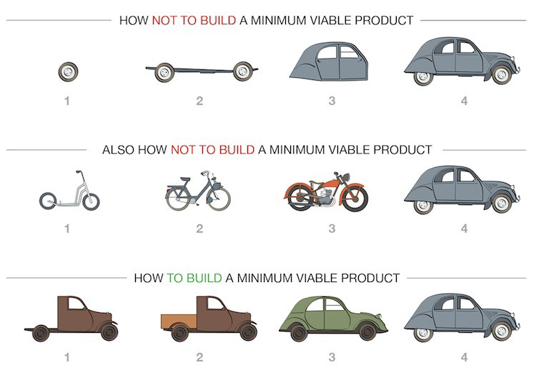
MVP
Notes:
Any questions about tonight’s agenda, objectives, goals, or timeline? Assignments & Prep work?

Slide 10
Identifying Your MVP
MVP or minimally viable product
What is the least amount of work I can do in order to show functionality for a given user story?
Think “How can I get this done quickly BUT accurately”
You can always go back and fix things once you get feedback on it
Additional Stories are flagged as “nice to haves” and thrown in the Backlog
Notes:
The agile photo is here because if you recall we will demo once we are completed with a sprint so ….
The key is to have something workable, as hopefully you can show employers at any time

Slide 11
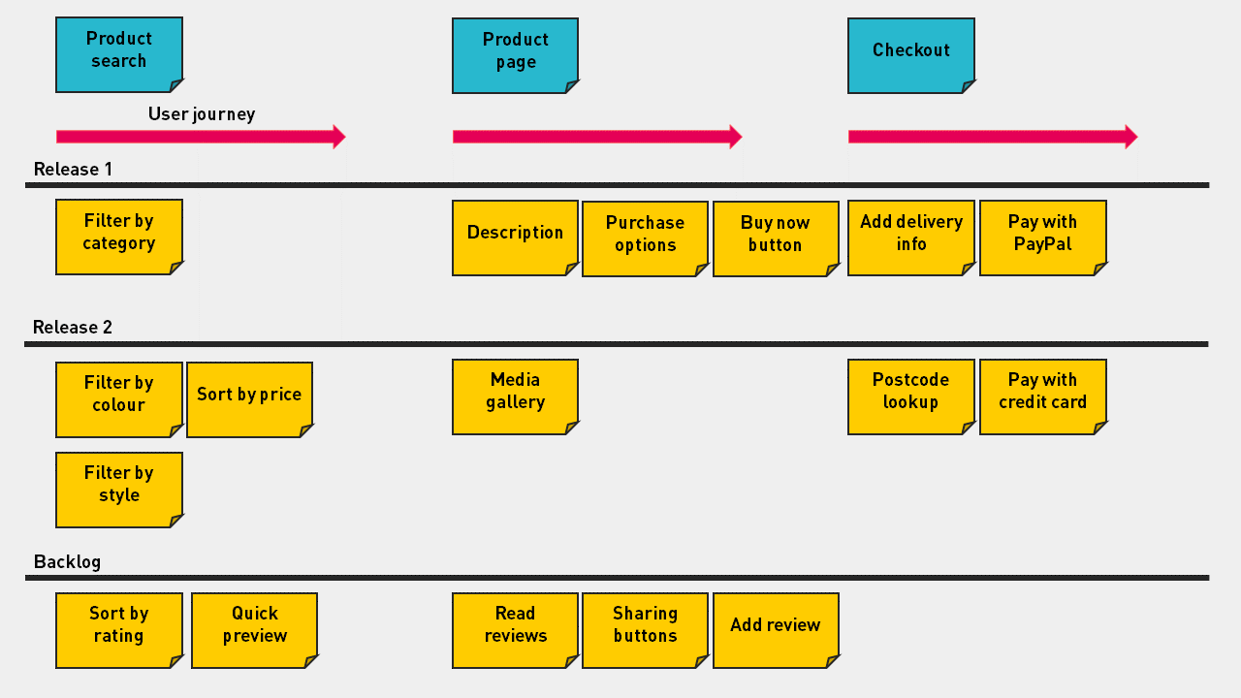
Identify Your MVP - eCommerce Example

Slide 12
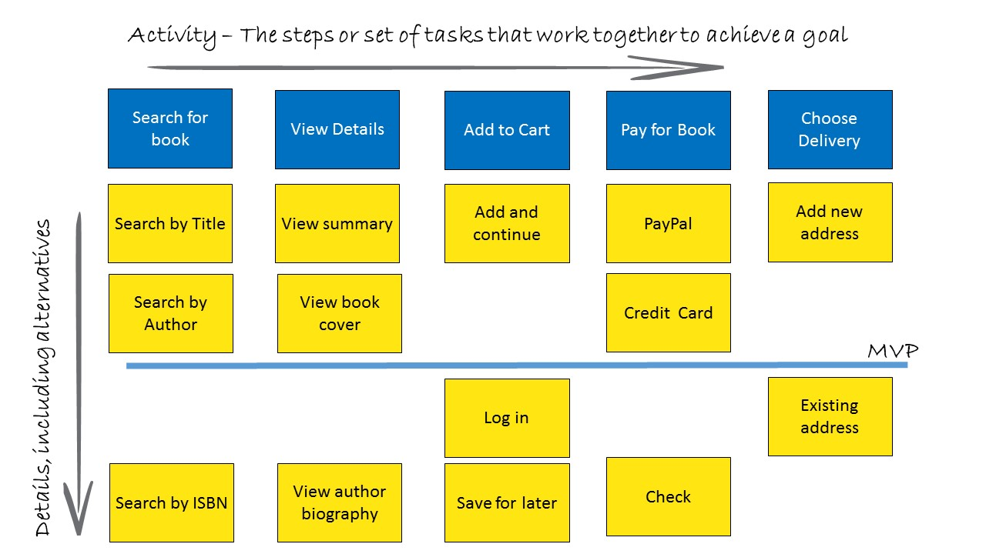
Story Mapping - Bookstore Example
Notes:
Notice non-essential features are below MVP (Log In)

Slide 13

Agile Continued
Notes:
Every team is different, interview questions

Slide 14
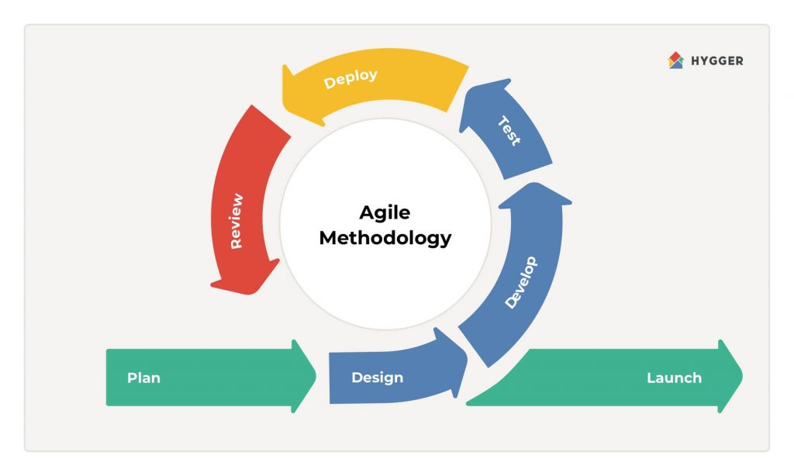
Recall what Agile look like
Sprint grooming/refinement
Sprint planning
Design what the work
Code the work (interchangeable with 5)
Test the work (QA maybe?)
Code Review
Deploy to “dev” env
Launch release
7
5
6
4
1
2
3
8
Demo between 7 and 8
Notes:
Recall from last lecture Agile looks something like this in sprints. What does that mean well…

Slide 15

Agile - Daily Scrum
What You Did
What You’re Working On Next
Any Blockers
Not a Status Meeting

Slide 16

Agile - Review
Demo Work at End of Sprint
Review Stories
Get Feedback From Stakeholders
Create New Stories

Slide 17
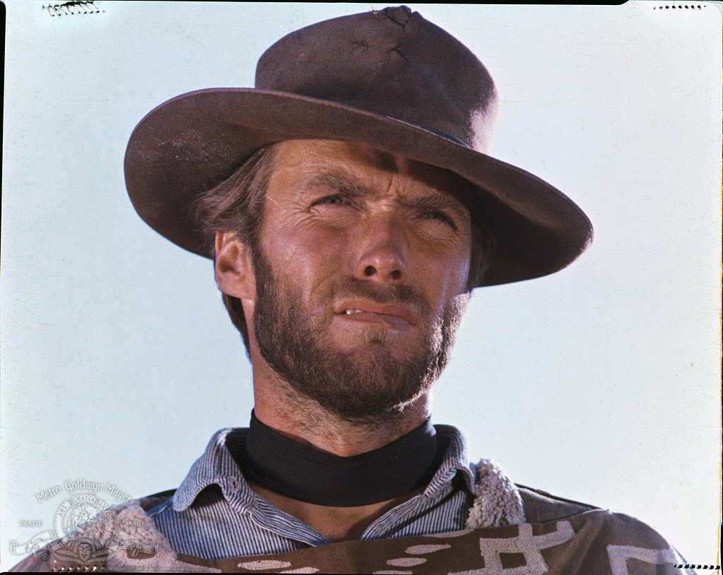
Agile - Retrospective
Independent of a Review or Demo
Regular Team Reflection
What Went Well?
What Didn’t?
What Can We Do to Change?
Safe Space to Address Team Issues

Slide 18
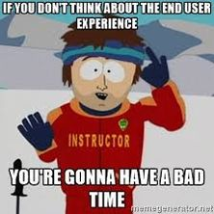

User Experience & Wireframing

Slide 19
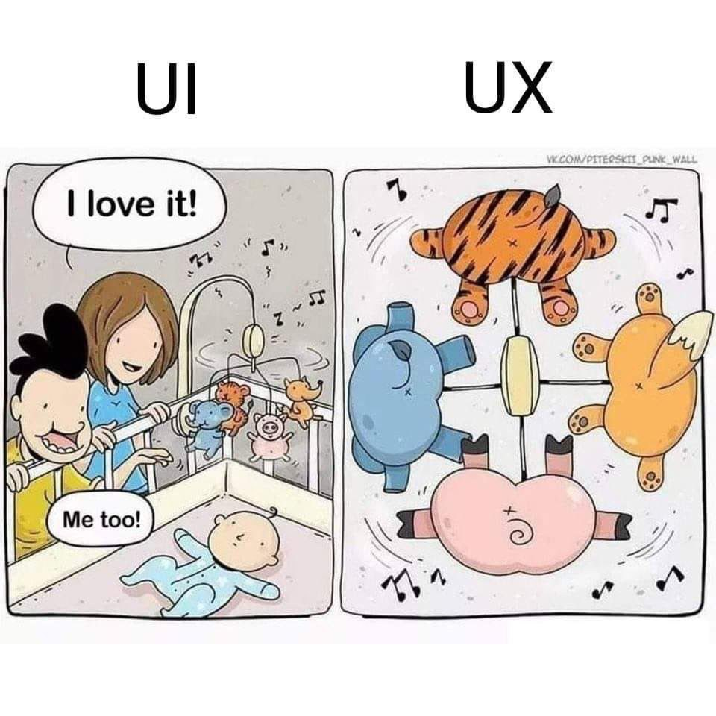
Why User Experience (UX) Matters
The Most Important Part of Your Application is the Users
Helps Visualize Users’ Journey
Gives Context To Our Work

Slide 20
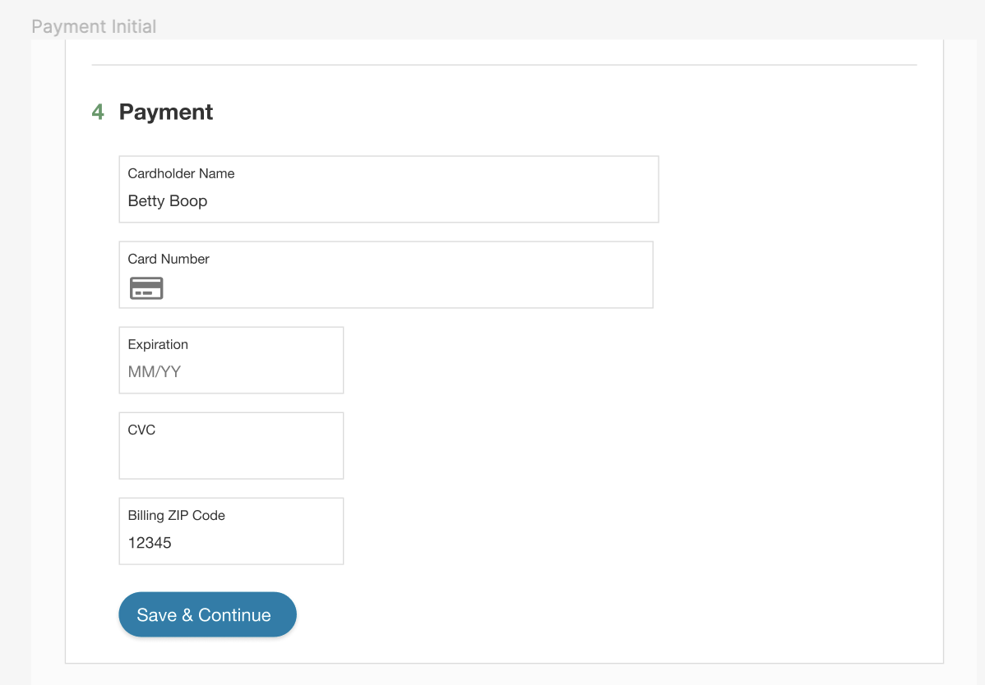
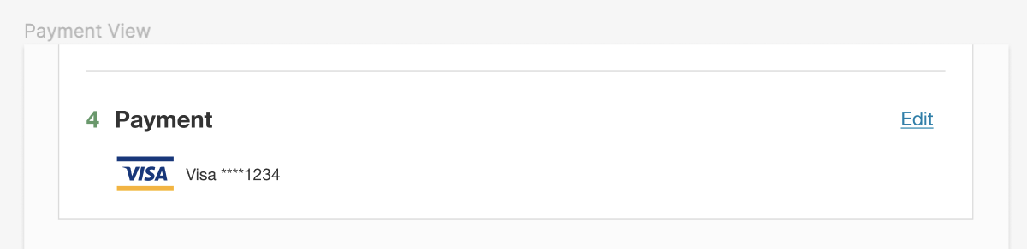
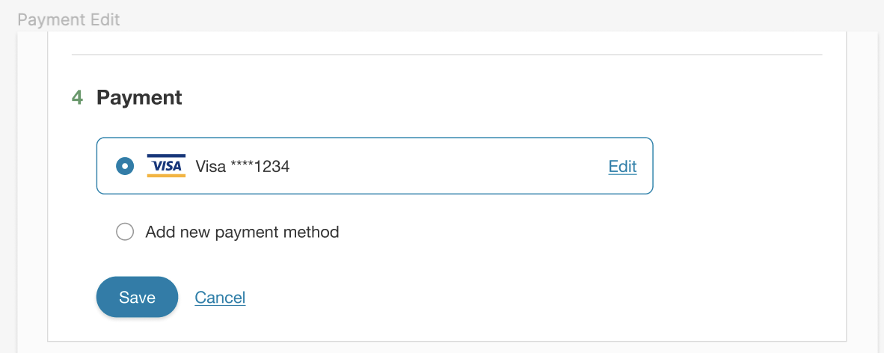
Payment Wireframe Examples with Figma
*Allegedly not the real screen

Slide 21
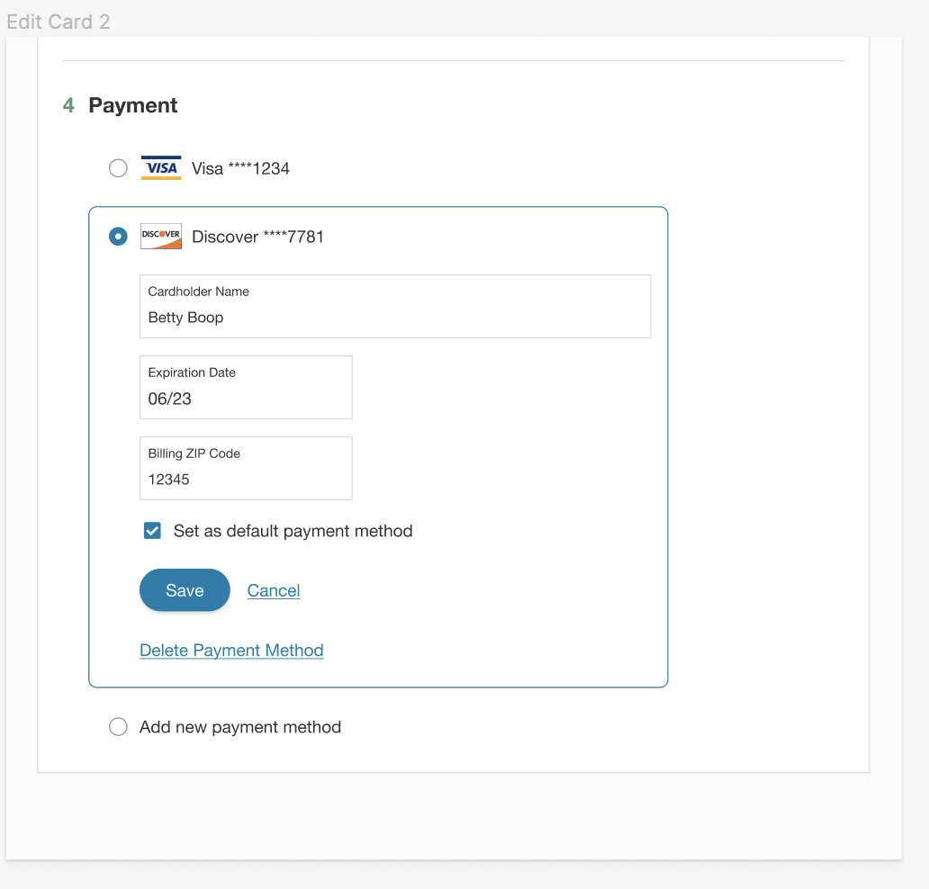
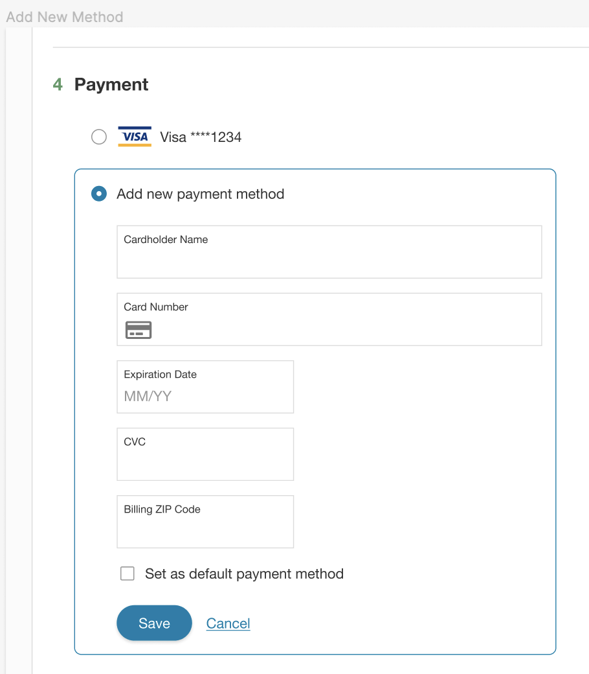
Payment Wireframe Examples with Figma Continued
*Allegedly not the real screen
Notes:
So these are all cool and stuff but how do they work in a real work flow?! Well I’m glad you asked

Slide 22

Wireframing Goals
Establish Vision Early
Identify Potential Problems Early
Create Your Page Hierarchy and Layout
Understand Your Information Architecture
Highlight User Interaction & Journey
Establish Shared Understanding & Perspective
Users
Business
Teammates

Slide 23
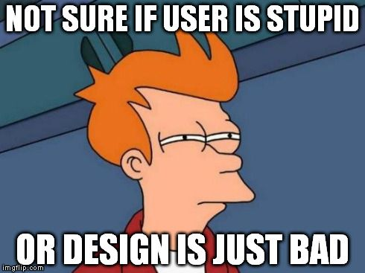
Wireframing Tips
Anyone Can Wireframe
Keep It Simple (Low Fidelity)
Stick To A Grid
Share With Others
Iterate

Slide 24
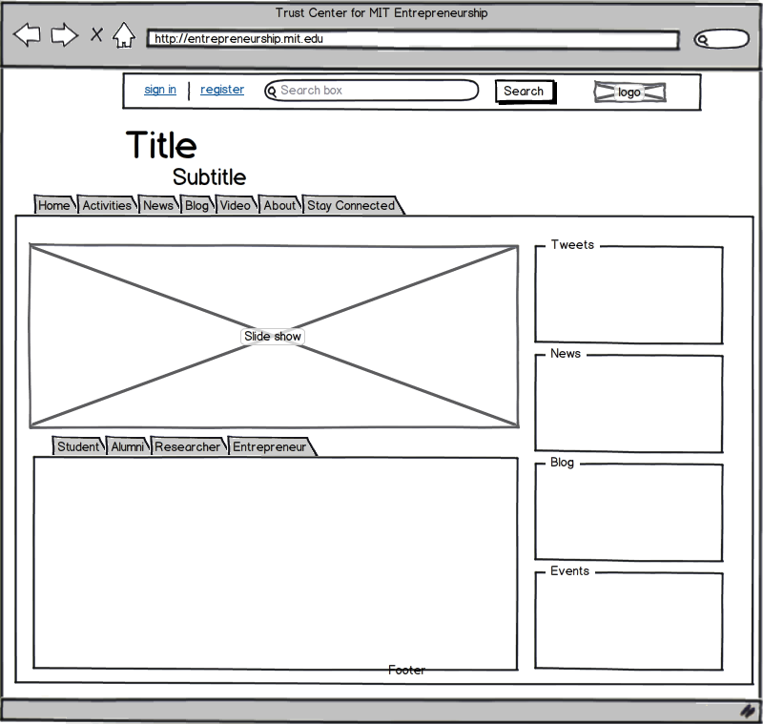
Wireframing Tools
Tools
Pen and Paper / Whiteboards
Balsamiq, Figma, Miro
https://moqups.com/
Anything BUT MS Paint
Resources
Liftoff UX Resources
Notes:
Plz no Paint, but use what’s comfortable

Slide 25
How do you turn user stories and wireframes into code?
Notes:
Well here is a perfect story for you!
RxSS has a user story: “

Slide 26
As a member of RxSS, I want to receive my prescription at home (home delivery), so that I don’t have to pay in person pharmacy mark up.
Notes:
Well they achieve this but then they found out that only 25% of people who started a Home Delivery actually finished. Naturally, we asked why was this and we found out our first iteration for this story was only giving members the ability to receive medications at home. They still had to use a 3rd party application to pay outside of our site.
INSERT A New User Story:
“As the Head of Product at RxSS, I want more members utilizing Home Delivery, so that we provide a better UX and save our members even more money”

Slide 27
As the Head of Product at RxSS, I want more members utilizing Home Delivery, so that we provide a better UX and save our members even more money
Notes:
“As the Head of Product at RxSS, I want more members utilizing Home Delivery, so that we provide a better UX and save our members even more money”
Now we are going to look at how we are implementing this user story into wireframes (can not so the code sorry :D)

Slide 28
Git Workflows
Notes:
Any mentor feedback about agile process or ceremonies?

Slide 29
Common Git Workflows
The most common workflows you’ll encounter involve the following steps:
1) Checkout/clone the project from GitHub (git clone …)
2) Build the project’s master branch (Before making any changes!)
3) Branch off the project’s master branch
4) Code, Test, & Commit to your branch (and push to remote)!
5) Code Review
6) Merge back into master
7) Build again
8) Push master branch into GitHub

Slide 30
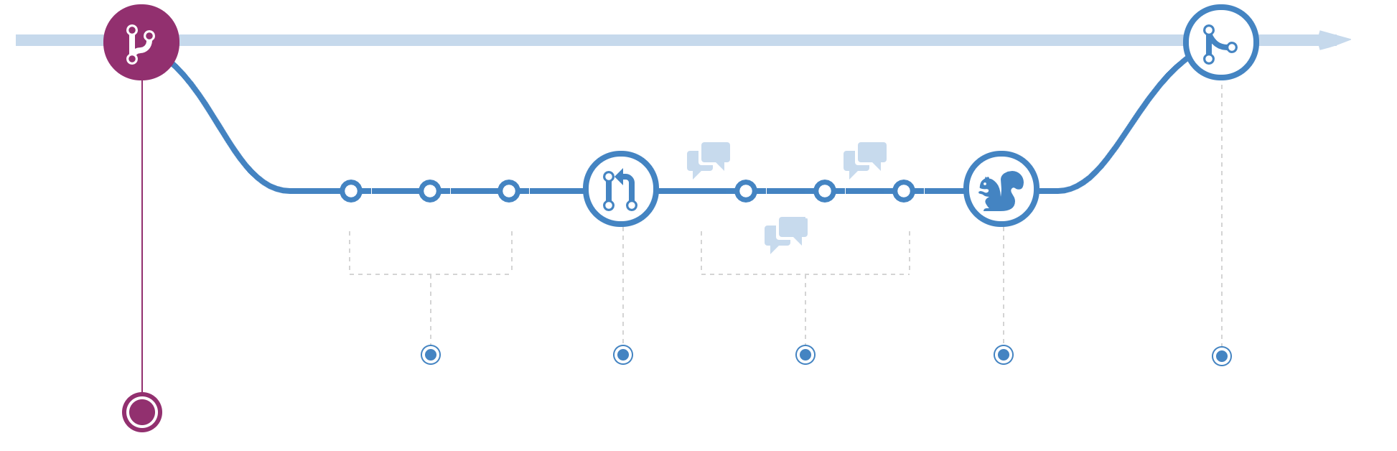
Create a Branch

Slide 31
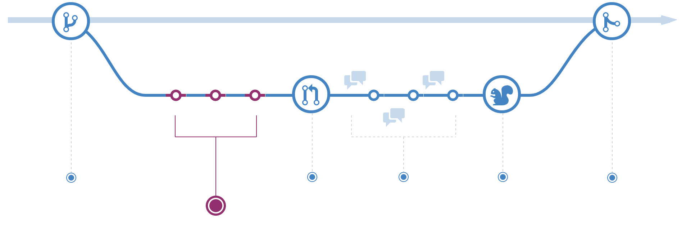
Add Commits

Slide 32
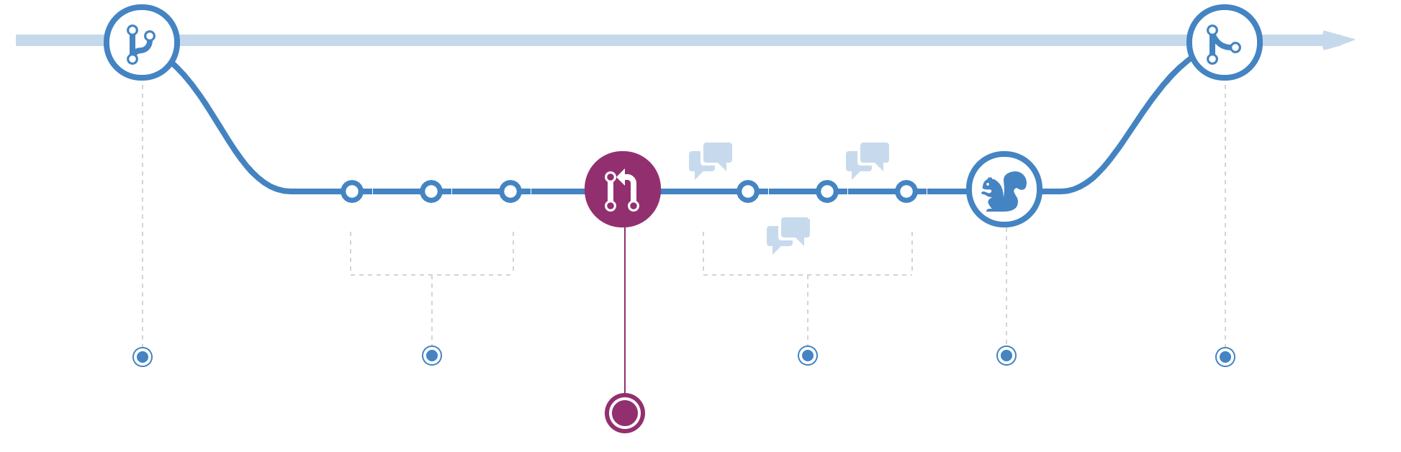
Open a Pull Request

Slide 33
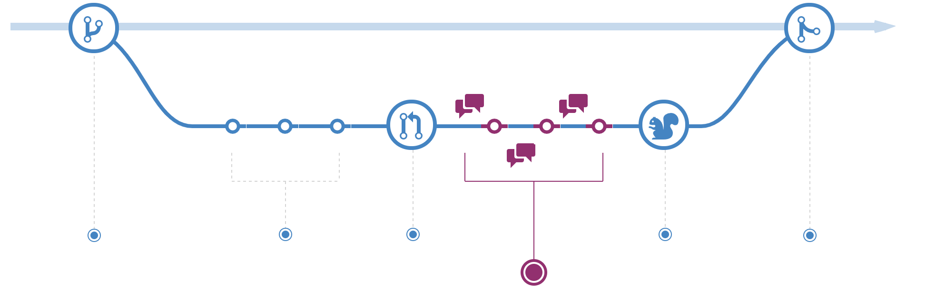
Discuss and Review Code

Slide 34
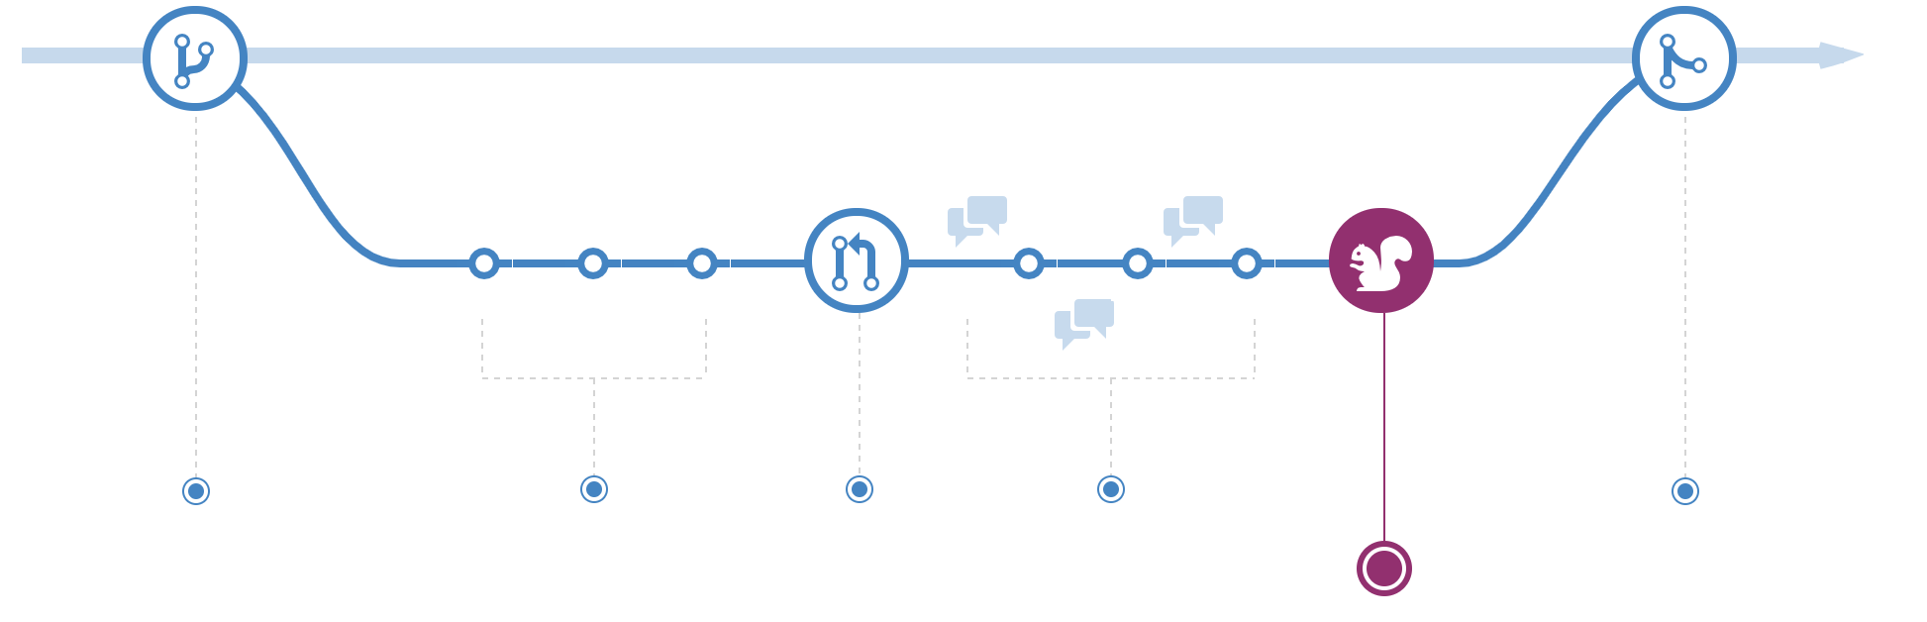
Deploy*

Slide 35
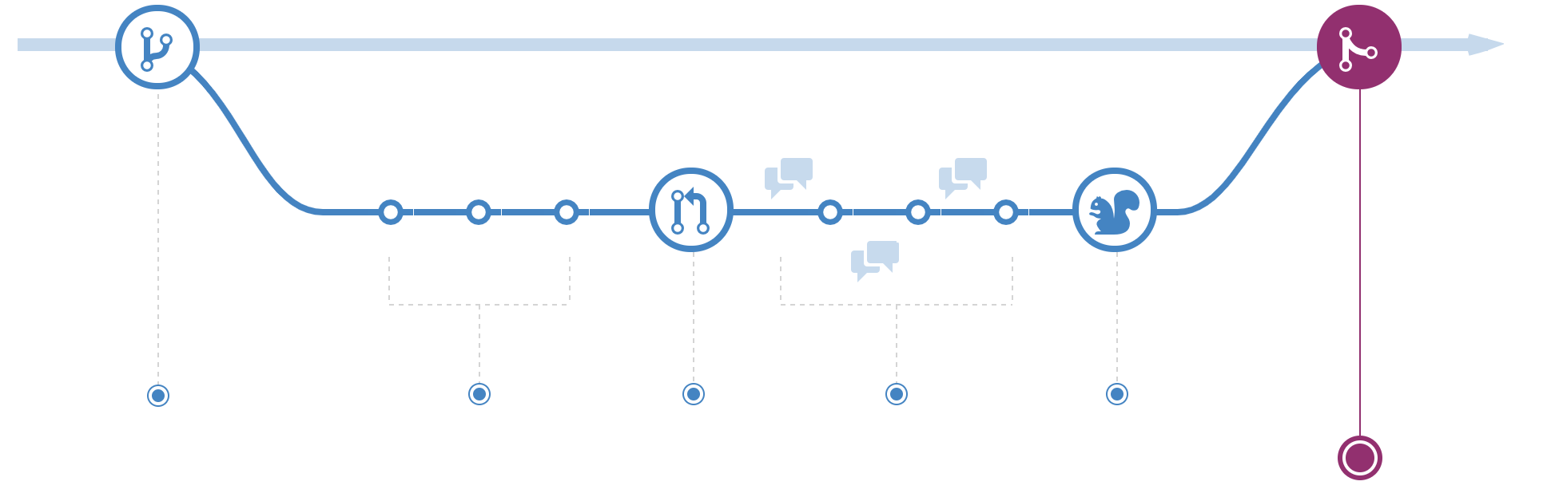
Merge

Slide 36
Uncommon (and unpleasant) Git Workflows
While the most common git workflow is great, there can be some hiccups.
Q: What if someone commits to master after you branched off?
If they touched the same file as you…
A: You’ll have a merge conflict!!! (nooooooooo!)
Two ways to handle a merge conflict
Handle the merge conflict manually by updating and marking the files
Rebase your branch with master before merging into master (you should do this)

Slide 37
Git DEMO
Notes:
Any mentor feedback about agile process or ceremonies?

Slide 38
Objectives Recap
How To Turn Ideas Into Code
How Wireframes Help Plan Your Project
How to Utilize Project Management Tools
Understand The Components Of A Sprint
How To Use Sizing To Estimate Work

Slide 39
Objectives Recap
Student should learn:
Why we use MVP
How Wireframes Help Plan Your Project
Build on our understand of an agile Sprint
Understanding basic git workflows
Notes:
Remember review time is coming up for TA, Instructors, and Course Managers. On that note If I confused you in this lecture my name is John Woolbright. If I did an ok job my name is Kevin Beashore. Of course I’m kidding :D and with that any questions?

Slide 40

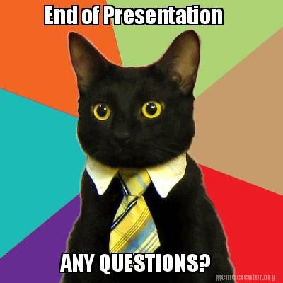
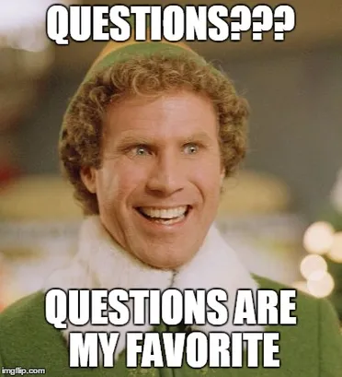
QuEsTiOnS
??????
QuEsTiOnS

